Slide 1
CobberChat
Gansaikhan Shur, Shristi Chapagain, Kinsey Younggren, Sachin Karki

Slide 2
1. Introduction

Slide 3
About this project
A simple chat application
Able to record conversations, emails
Add friends using email
Aimed for ease of use
Talk to your loved ones. Yea only I can read your messages :)

Slide 4
2. Work done so far

Slide 5
Work Done so far
Fully Functional
Able to use anywhere in the world
Database secured with encryption and password
Both Back-end and Front-end completed
Bugs? Never heard of

Slide 6
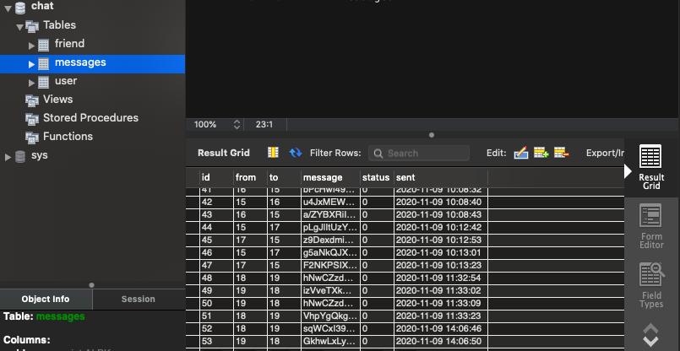

Slide 7
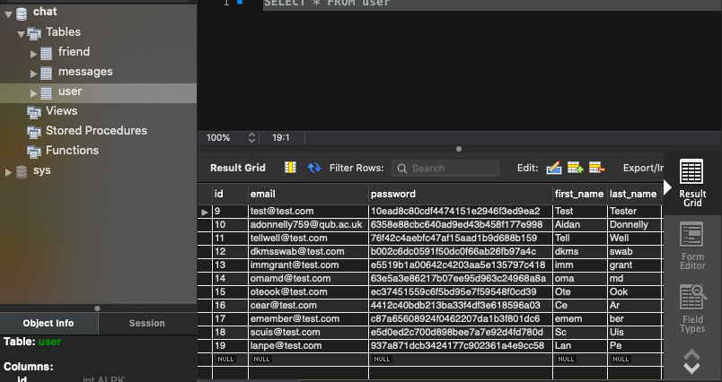

Slide 8
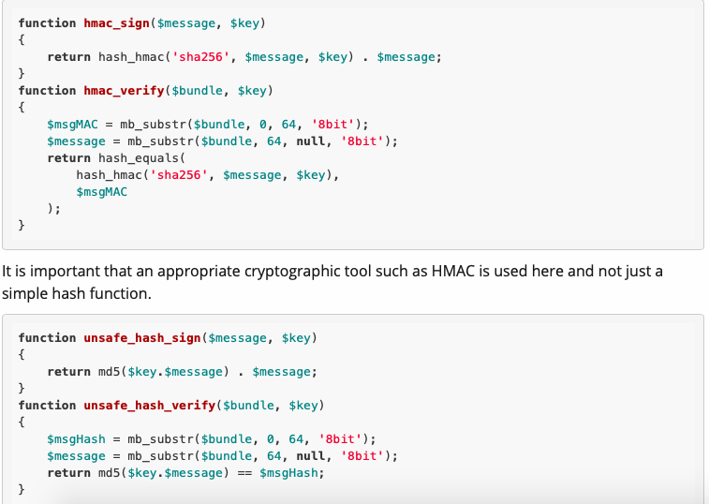
Using Encryption and Authentication Correctly (for PHP developers)
Source: https://paragonie.com/blog/2015/05/using-encryption-and-authentication-correctly

Slide 9
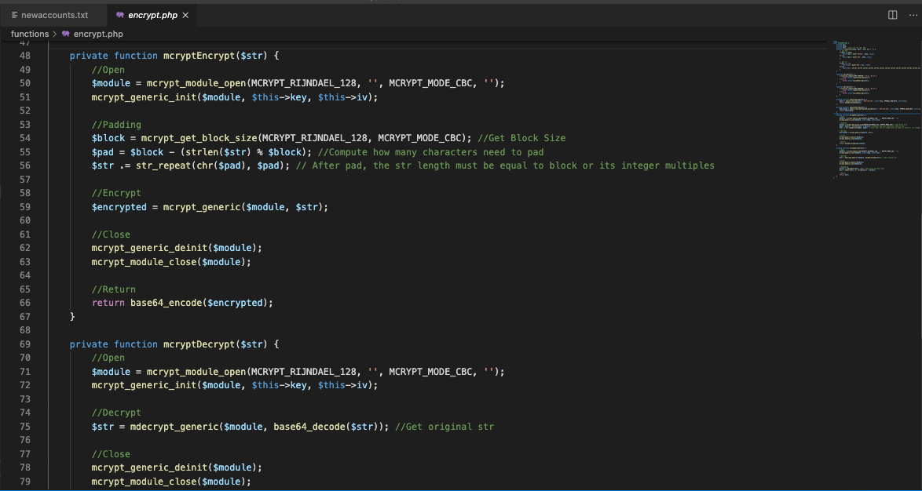

Slide 10
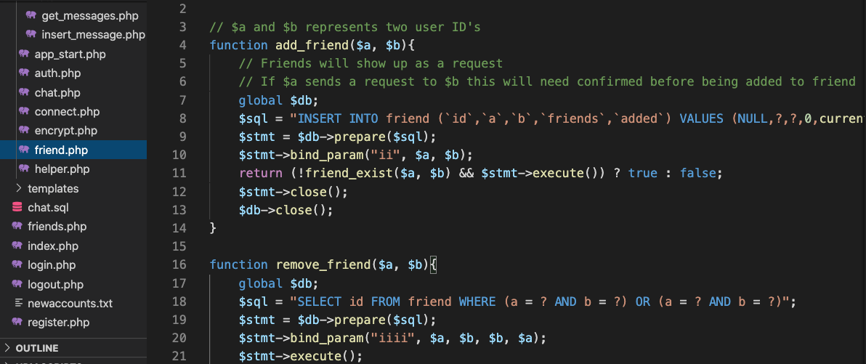

Slide 11
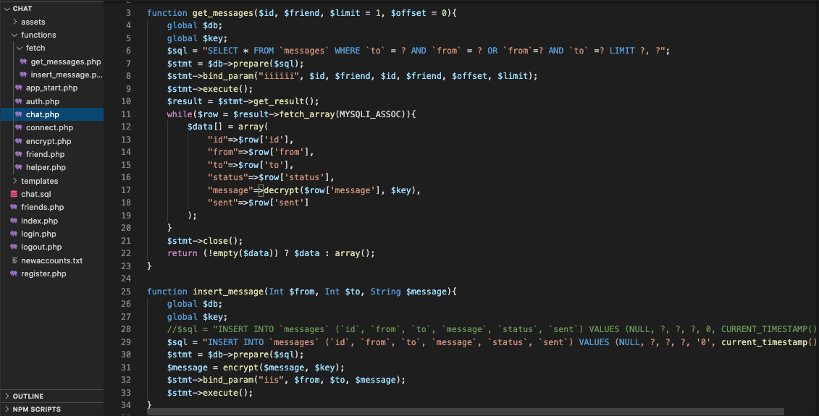

Slide 12
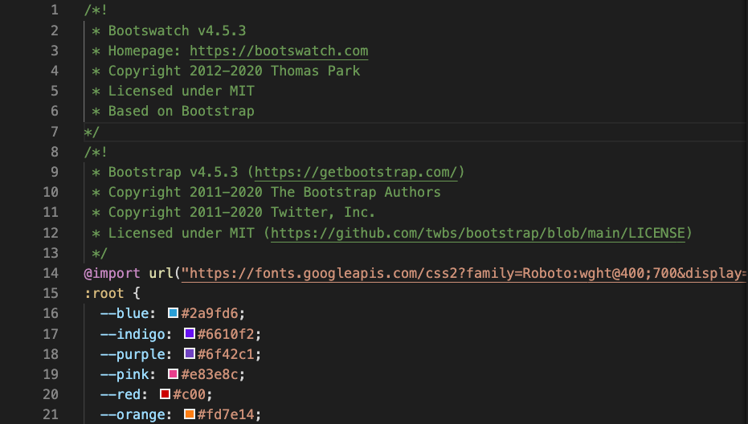

Slide 13
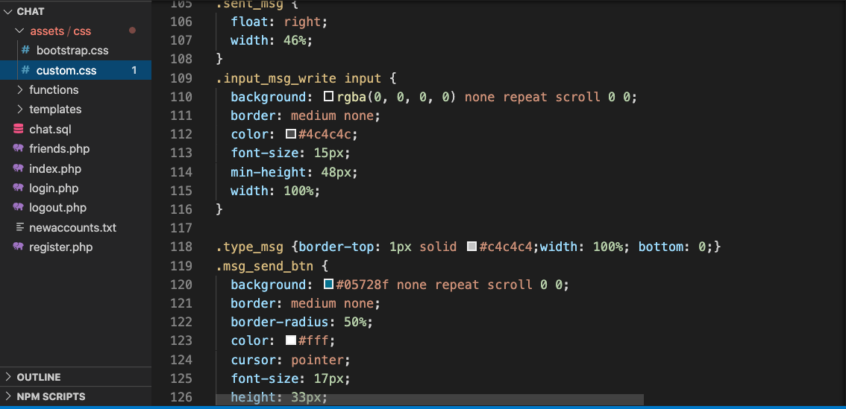

Slide 14
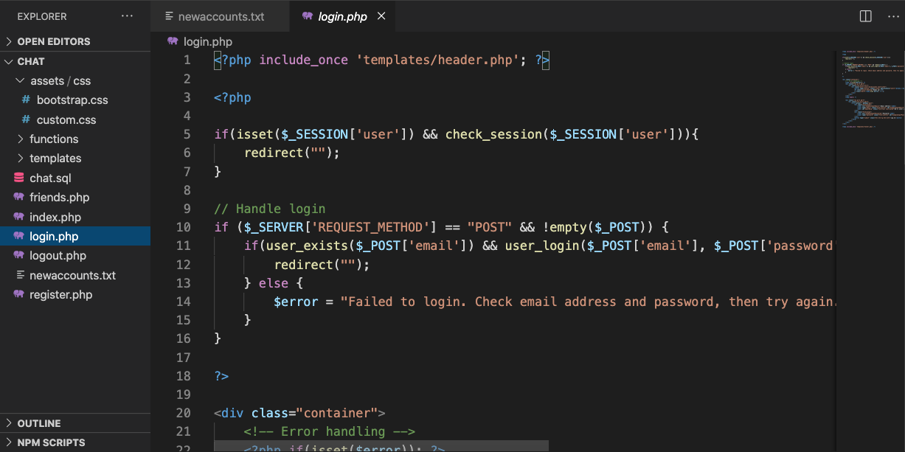

Slide 15
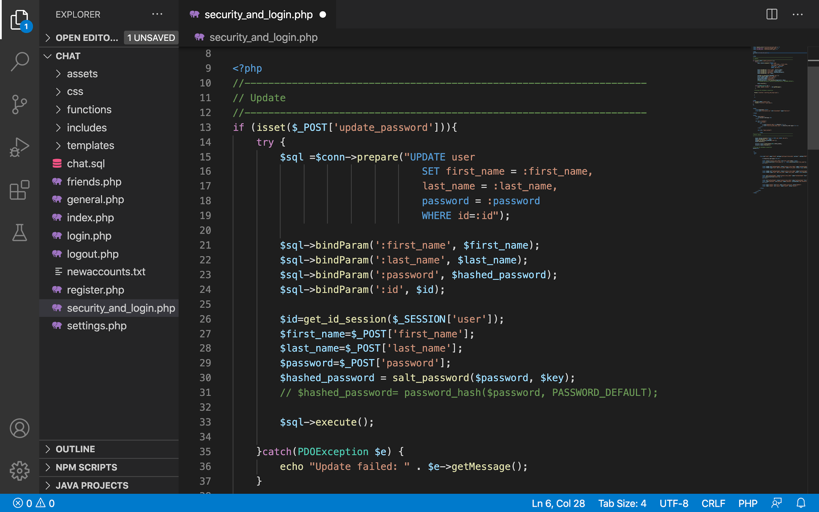

Slide 16
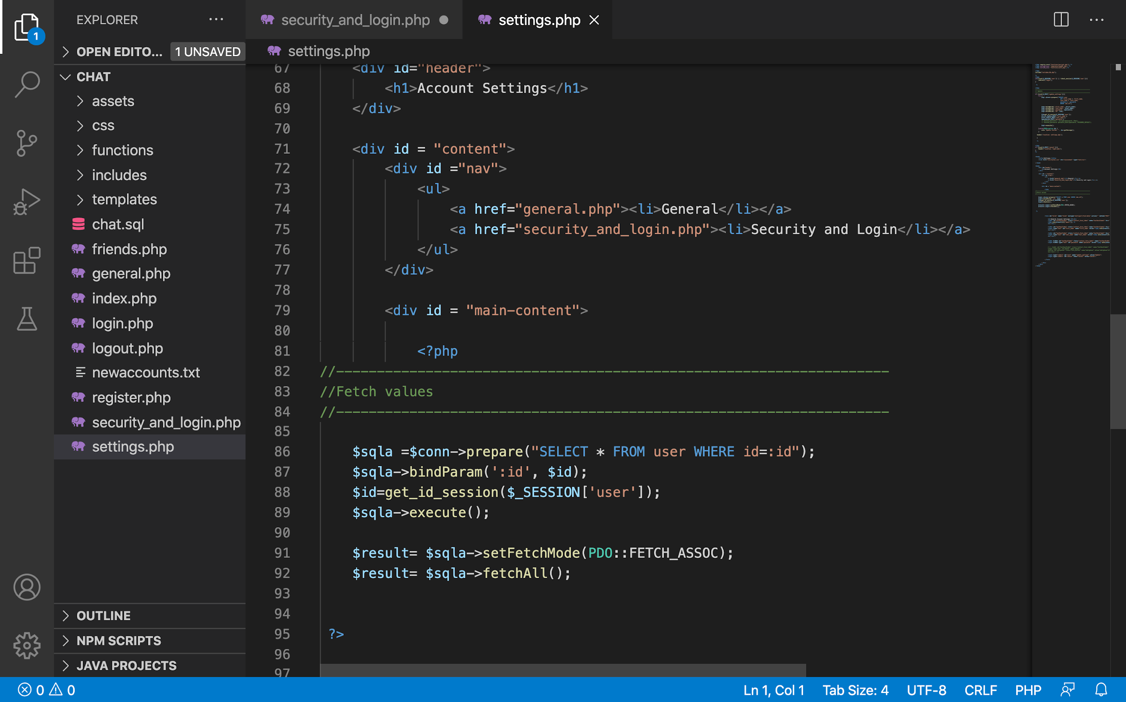

Slide 17
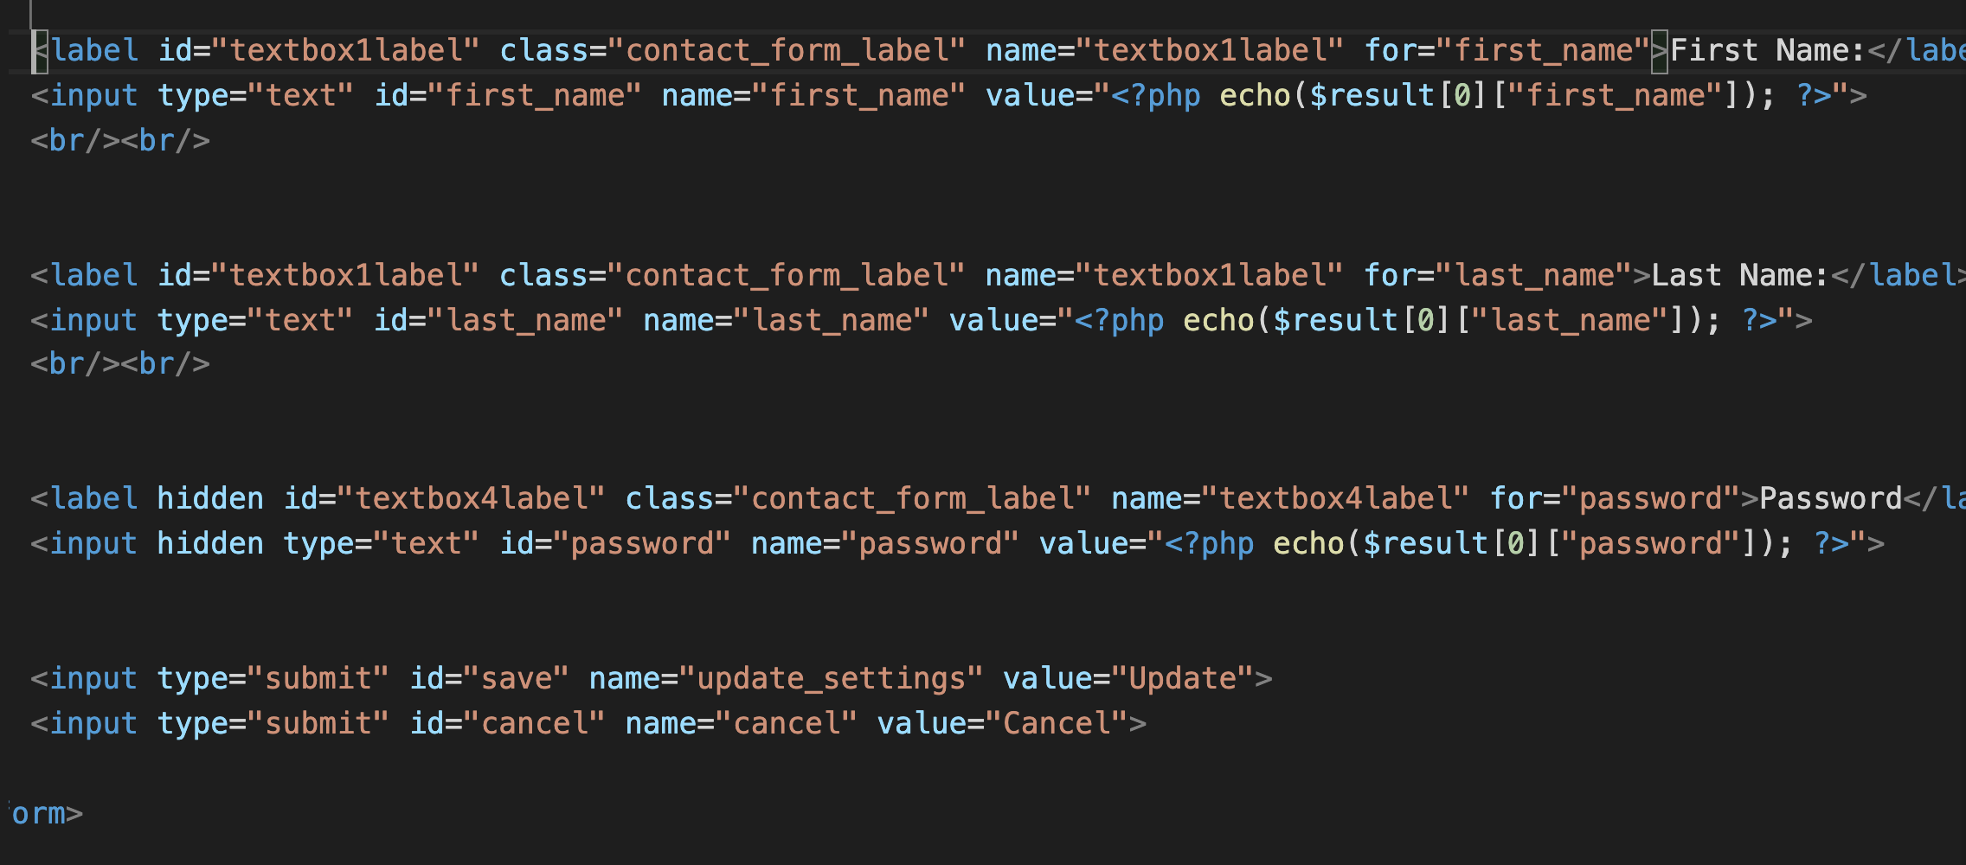

Slide 18
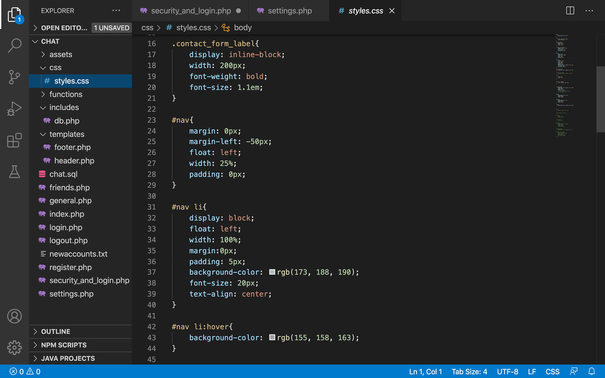

Slide 19
3. What has gone well

Slide 20
What has gone well
Team communication/coordination
Team effort
Willing to help each other out
Smooth workflow
Willingness to learn new things
Open to new challenges and problems

Slide 21
4. Challenges

Slide 22
Challenges
Figuring out who is friends with who
Finding the encryption key while updating the database
Combining the work together
Configuring config files

Slide 23
5. Conclusion

Slide 24
Conclusion
We all worked well together
Some challenges
Overall fun project to work on

Slide 25
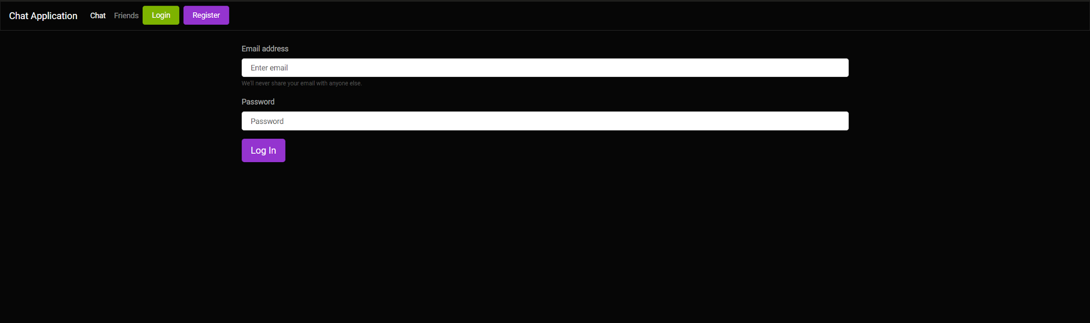
Project Demo
Place your screenshot here

Slide 26
Thanks!
Any questions?

